Slide 1
Shortest Path Routing
The idea is to build a graph of the network, with each node of the graph representing a router and each edge of the graph representing a communication line, or link.
To choose a route between a given pair of routers, the algorithm just finds the shortest path between them on the graph.
In the general case, the labels on the edges could be computed as a function of the distance, bandwidth, average traffic, communication cost, measured delay, and other factors.
By changing the weighting function, the algorithm would then compute the ‘‘shortest’’ path measured according to any one of a number of criteria or to a combination of criteria.
Several algorithms for computing the shortest path between two nodes of a graph are known. This one is due to Dijkstra (1959) and finds the shortest paths between a source and all destinations in the network. Each node is labeled (in parentheses) with its distance from the source node along the best known path.

Slide 2
Shortest Path Routing
The distances must be non-negative, as they will be if they are based on real quantities like bandwidth and delay. Initially, no paths are known, so all nodes are labeled with infinity.
As the algorithm proceeds and paths are found, the labels may change, reflecting better paths. A label may be either tentative or permanent.
Initially, all labels are tentative. When it is discovered that a label represents the shortest possible path from the source to that node, it is made permanent and never changed thereafter.

Slide 3
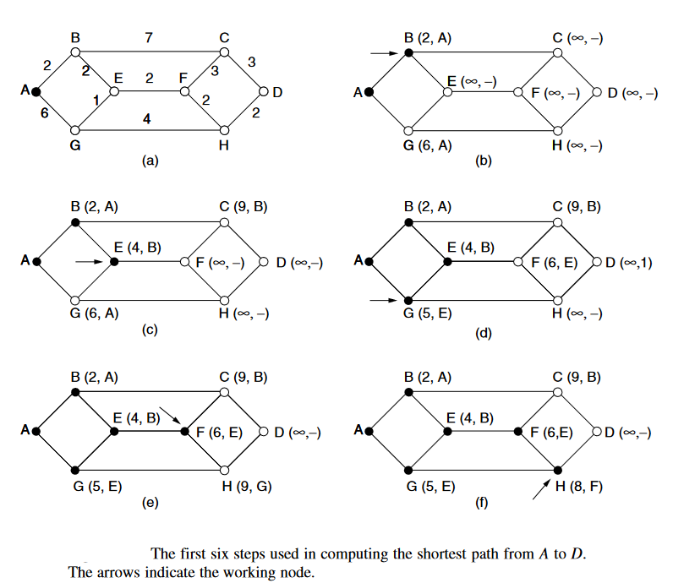
Shortest Path Routing

Slide 4
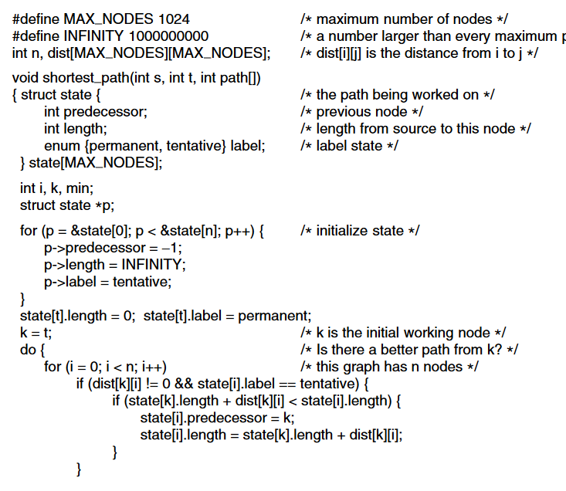
Shortest Path Routing-Dijkstra

Slide 5
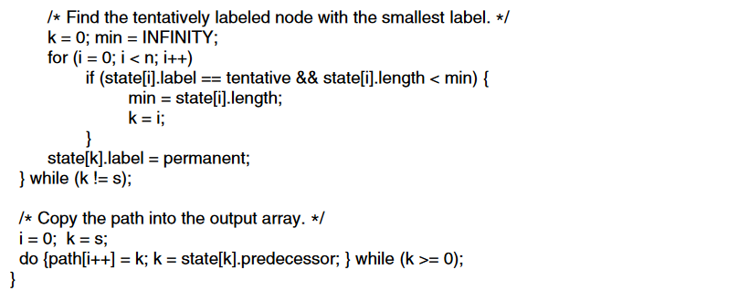
Shortest Path Routing-Dijkstra

Slide 6
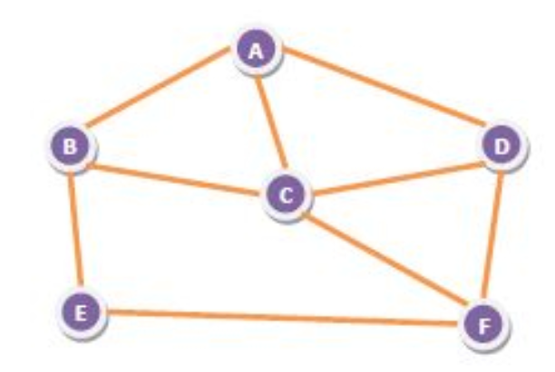
Flooding
Flooding is a non-adaptive routing technique following this simple method: when a data packet arrives at a router, it is sent to all the outgoing links except the one it has arrived on.
For example, let us consider the network in the figure, having six routers that are connected through transmission lines.
An incoming packet to A, will be sent to B, C and D.
B will send the packet to C and E.
C will send the packet to B, D and F.
D will send the packet to C and F.
E will send the packet to F.
F will send the packet to C and E.

Slide 7
Types of flooding
Uncontrolled flooding − Here, each router unconditionally transmits the incoming data packets to all its neighbours.
Controlled flooding − They use some methods to control the transmission of packets to the neighbouring nodes. The two popular algorithms for controlled flooding are Sequence Number Controlled Flooding (SNCF) and Reverse Path Forwarding (RPF).
Selective flooding − Here, the routers don't transmit the incoming packets only along those paths which are heading towards approximately in the right direction, instead of every available paths.

Slide 8
Flooding
Advantages of Flooding :
It is very simple to setup and implement, since a router may know only its neighbors.
It is extremely robust. Even in case of malfunctioning of a large number routers, the packets find a way to reach the destination.
All nodes which are directly or indirectly connected are visited. So, there are no chances for any node to be left out. This is a main criteria in case of broadcast messages. The shortest path is always chosen by flooding.
Disadvantages of Flooding :
Flooding tends to create an infinite number of duplicate data packets, unless some measures are adopted to damp packet generation.
It is wasteful if a single destination needs the packet, since it delivers the data packet to all nodes irrespective of the destination.
The network may be clogged with unwanted and duplicate data packets. This may hamper delivery of other data packets.

